Slide 1

this & Static
Module 2 _ Part 2

Slide 2
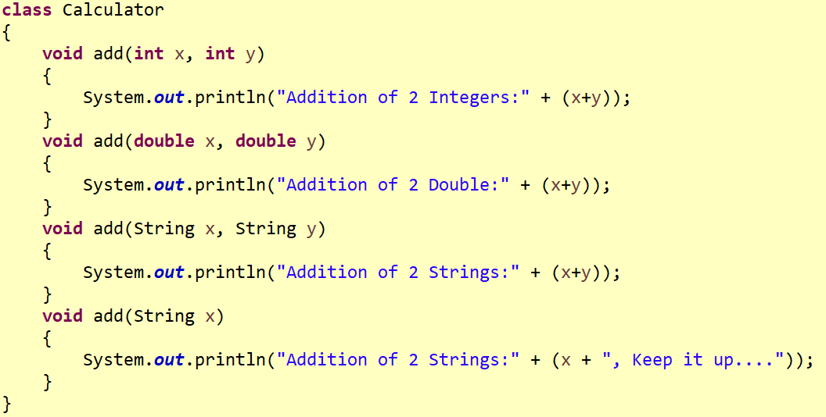
Method Overloading

Slide 3
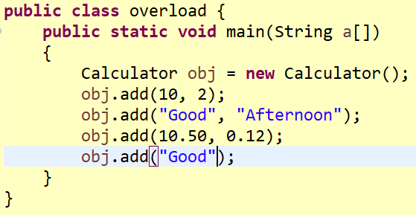
Method Overloading

Slide 4
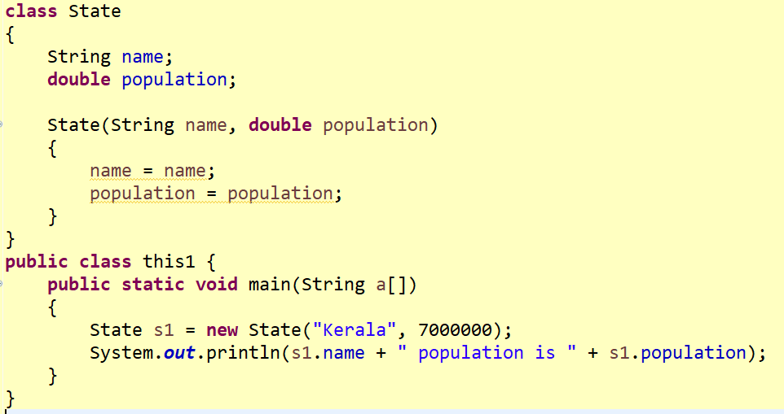
Need of ‘this’

Slide 5
Output
null population is 0.0
Name collision over instance and local variable in a method/constructor can be resolved by “this”

Slide 6
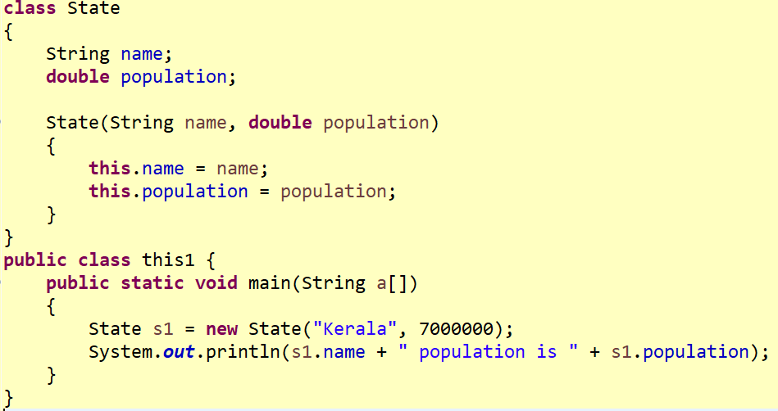
this - in Constructor
Kerala population is 7000000.0

Slide 7
this Keyword
this - Reference to the object of the current class, with in an instance method or a constructor
Refer current class instance variable
Passed as argument in the constructor call / Method call
Return the current class instance from the method
Invoke current class method
Invoke current class constructor

Slide 8
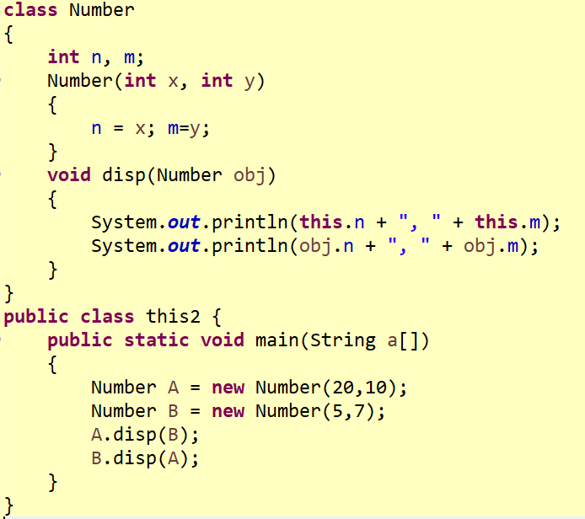
this - in Method

Slide 9
Output
20, 10
5, 7
5, 7
20, 10

Slide 10
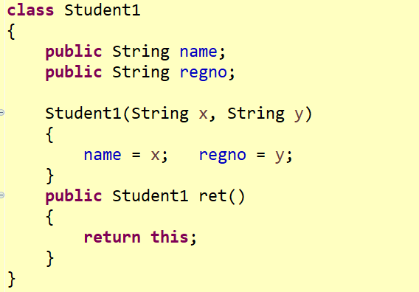
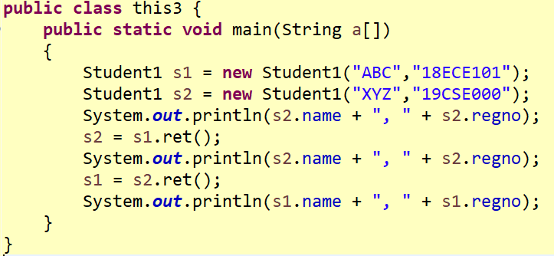
this - as Return Type

Slide 11
Output
XYZ, 19CSE000
ABC, 18ECE101
ABC, 18ECE101

Slide 12
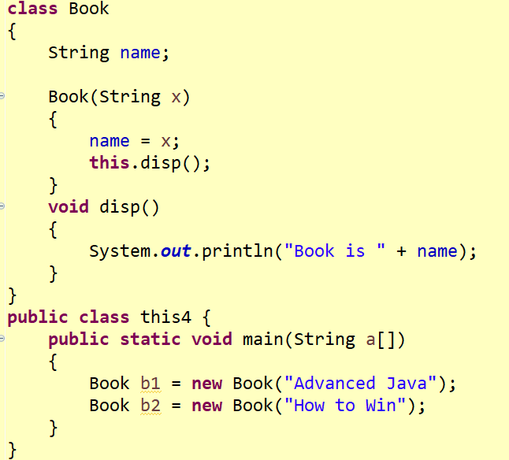
this - in Method Calling

Slide 13
Output
Book is Advanced Java
Book is How to Win

Slide 14
Student’s Practice Programs
Find the Euclidean distance between 2 coordinates using this object.
Addition of two complex numbers using this object

Slide 15
Static
Static is used for memory management, it can apply with
Variable
Method
Block
Nested class

Slide 16
Static Variable
To refer the common property of all objects (which is not unique for each object)
The static variable gets memory only once in the class area at the time of class loading.
Advantage is it makes your program memory efficient.
Static datatype variable_name = “ “;

Slide 17
Static method
A static method belongs to the class rather than the object of a class.
A static method can be invoked without the need for creating an instance of a class.
A static method can access static data member and can change the value of it.
Static void method_name()
{ }

Slide 18
Why is the java main method static?
the object is not required to call a static method.
If it were a non-static method, JVM creates an object first then call main() method that will lead the problem of extra memory allocation.

Slide 19
Static block
Is used to initialize the static data member.
It is executed before the main method at the time of class loading.

Slide 20
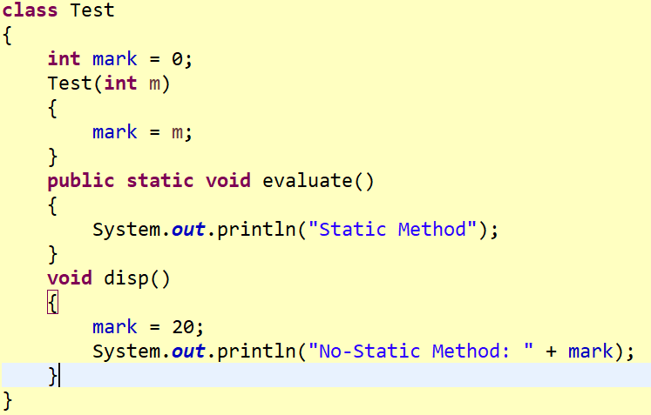
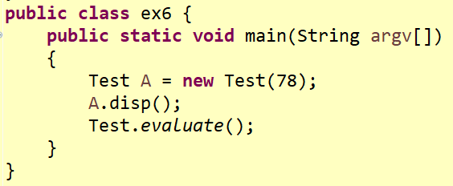
Static & Non Static Method
Class Name; not an Object
No-Static Method: 20
Static Method

Slide 21
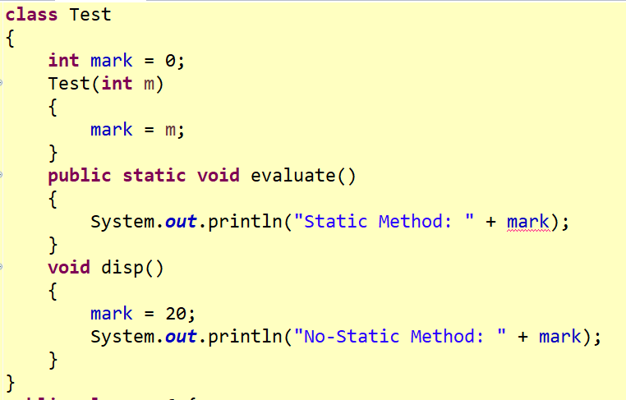
Static Method – Depends on Class; not on Object

Slide 22
Output
java.lang.Error: Unresolved compilation problem:
Cannot make a static reference to the non-static field mark

Slide 23
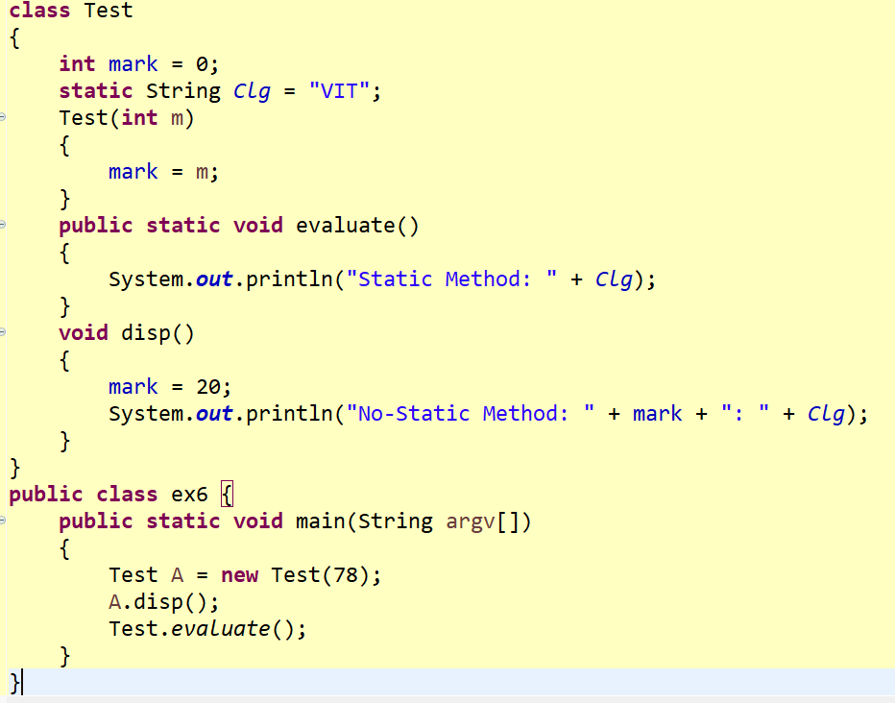
Static Member Variable
No-Static Method: 20: VIT
Static Method: VIT

Slide 24
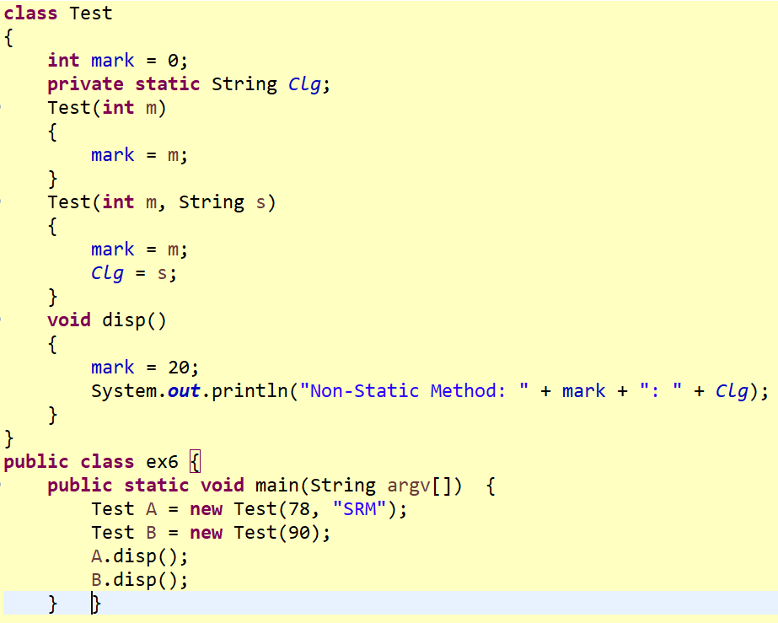
Static Member Variable

Slide 25
Output
Non-Static Method: 20: SRM
Non-Static Method: 20: SRM

Slide 26
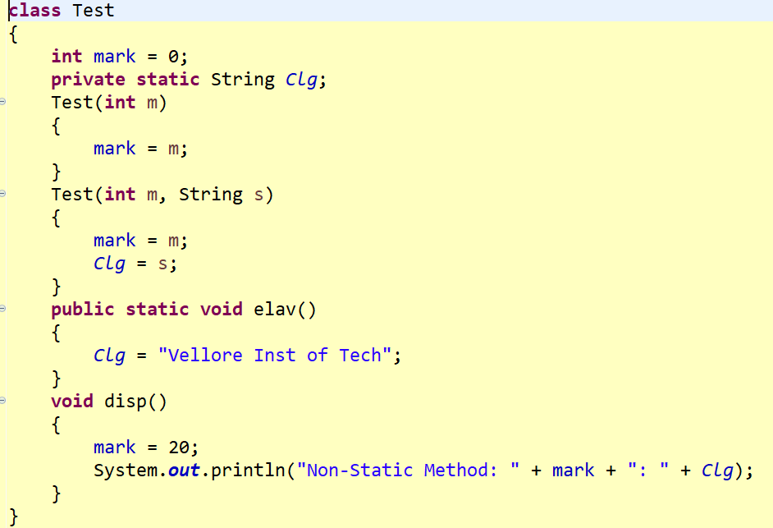
Static Member Variable

Slide 27
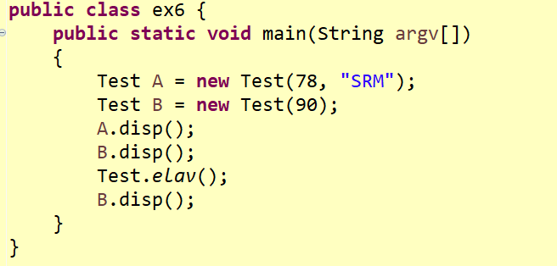
Static Member Variable
Non-Static Method: 20: SRM
Non-Static Method: 20: SRM
Non-Static Method: 20: Vellore Inst of Tech

Slide 28
Task
Create 5 objects for Student class with the same Institution name (VIT) and School other than Name of the Student, Register Number and Year of studying. Use static concept.

